Slide 1


Exploring the future of job search technology
Job Hunt AI: Revolutionizing Job Recommendations
Discover how AI enhances user-centric experiences in job searching and recommendations.

Slide 2


The Problem: The Job search Black Hole
Why It ‘s so overwhelming to get the most relevant job for me ?
The modern job search is a frustrating and inefficient process for even the most qualified candidates.
Information Overload: The market is flooded with keyword-based search tools that produce a high volume of irrelevant "noise".
The "Relevance" Gap: A staggering 89% of job seekers report that their biggest challenge is "finding job postings that are actually relevant to my skills and experience".
The "Ghost Job" Epidemic: Countless hours are wasted on "ghost jobs"—postings that are outdated or no longer actively hiring.
The Resume Black Hole: Candidates are forced to spend endless hours tailoring their resumes to pass through arbitrary Applicant Tracking System (ATS) filters, with little to no feedback.

Slide 3
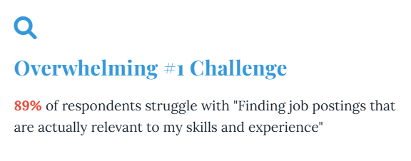
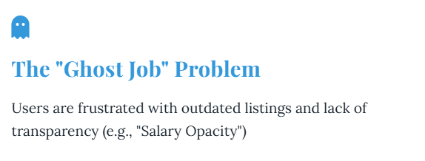
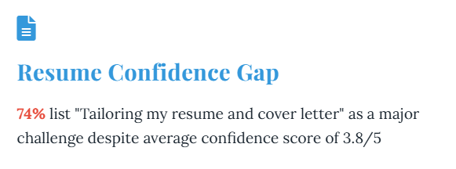
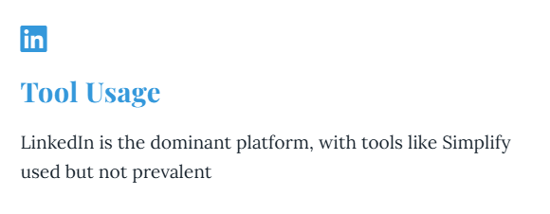
Key Insights from the Survey

Slide 4
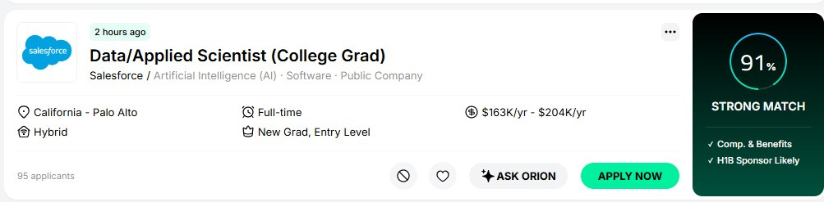

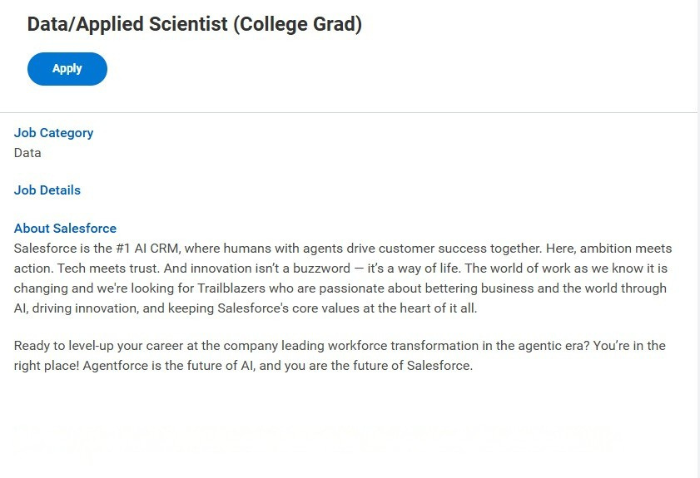

Why is there a Need?
Why 91% ?
This role is only open to to prior Salesforce interns. All others who do not meet this criteria will not be
considered.

Slide 5
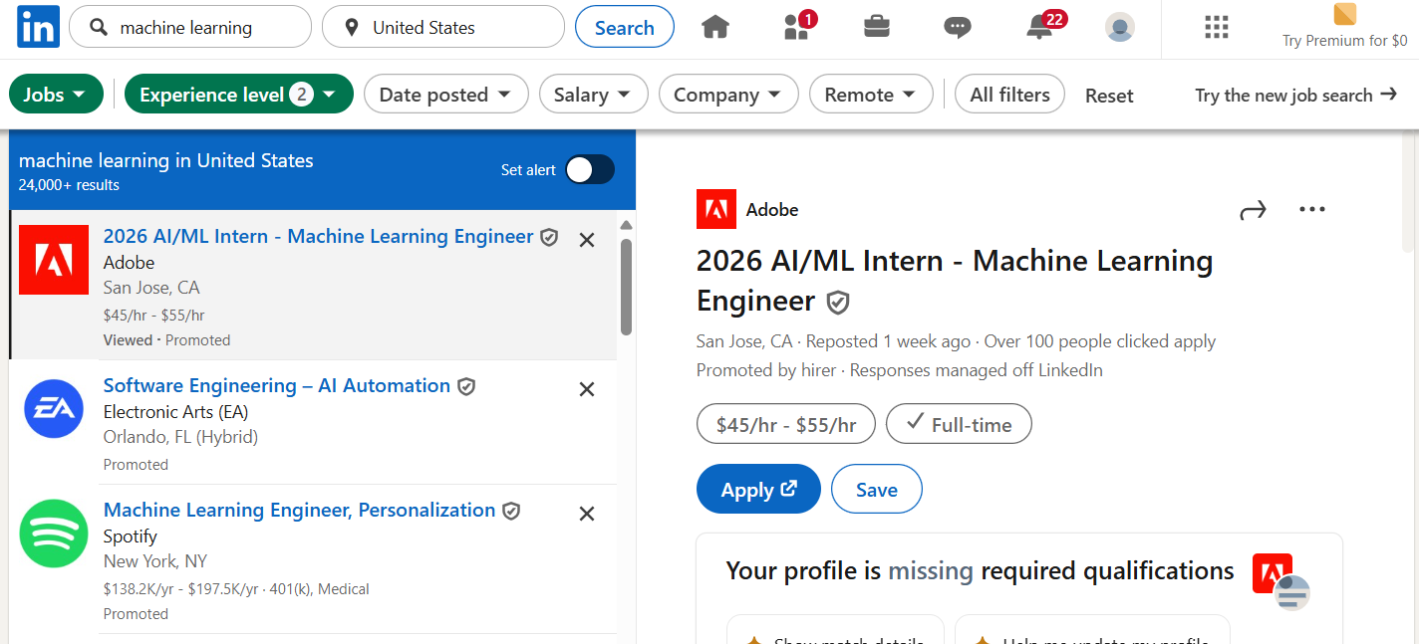

Why is there a Need?
Why can’t i feel any confidence ?

Slide 6




Solution: Job-Hunt AI
Sematic Search
Enhanced Personalization
Resume Optimisation
In Context Interview Preparation
Our core innovation is an AI descriptive search engine that understands the semantic essence of a candidate's profile and matches them with opportunities that are a true fit.
We are not just another job board; we are a career companion that empowers job seekers to find their dream job, faster.

Slide 7
Recommendation System (Agentic Architecture)
Problem Addressed: Tackles the person-job fit challenge in recommender systems and NLP (Bian et al., 2020), which has traditionally been approached using deep models such as RNNs and GNNs (Qin et al., 2018) to match resumes with JD. Incorporating agent orchestration here (e.g. an agent that reads a user’s resume, identifies missing skills, searches job postings, and iteratively refines search) would be cutting-edge.
Proposed Innovation: Leverage LLMs for:
Data enrichment & augmentation, inspired by ConFit v2 (Yu et al., 2025), which generates hypothetical resumes.
Agent orchestration, where an LLM-driven agent reads resumes, identifies skill gaps, searches jobs, and iteratively refines matches.
Research Opportunities:
Developing low-supervision matching systems to address data sparsity (Bian et al., 2020).
Exploring fairness and bias mitigation in automated hiring (Iso et al., 2025).
Target Venues: RecSys, SIGIR, ACL (Industry Track), and A* conferences focusing on fairness and AI ethics.
Core of Job-Hunt AI

Slide 8
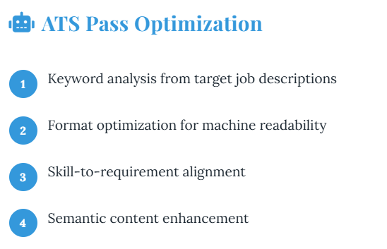
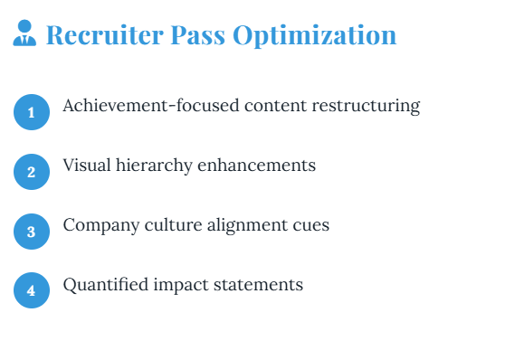

Resume Optimisation (Prompt Engineering)
Core of Job-Hunt AI

Slide 9
Multi-Modal Interview Preparation:
Core Idea: A novel pipeline of cooperating agents (OCR → retrieval → Q&A generation → speech dialogue) orchestrated by LLMs to simulate realistic interview scenarios.
Modalities Integrated: Combines text (resumes, documents), vision (OCR), and speech (dialogue) for a rich, interactive experience.
Proposed Framework:
The agent scans the user's resume or company documents via OCR.
Retrieves relevant facts/questions using a vector store.
Creates a Plan and simulates an interview using LLMs to ask and evaluate responses.
Novelty: Goes beyond static Q&A or VR-based trainers by dynamically adapting to user input and context.
Target Venues: AAAI, NeurIPS, CHI—especially for work on LLM-based task simulation and human-AI interaction.
Core of Job-Hunt AI

Slide 10
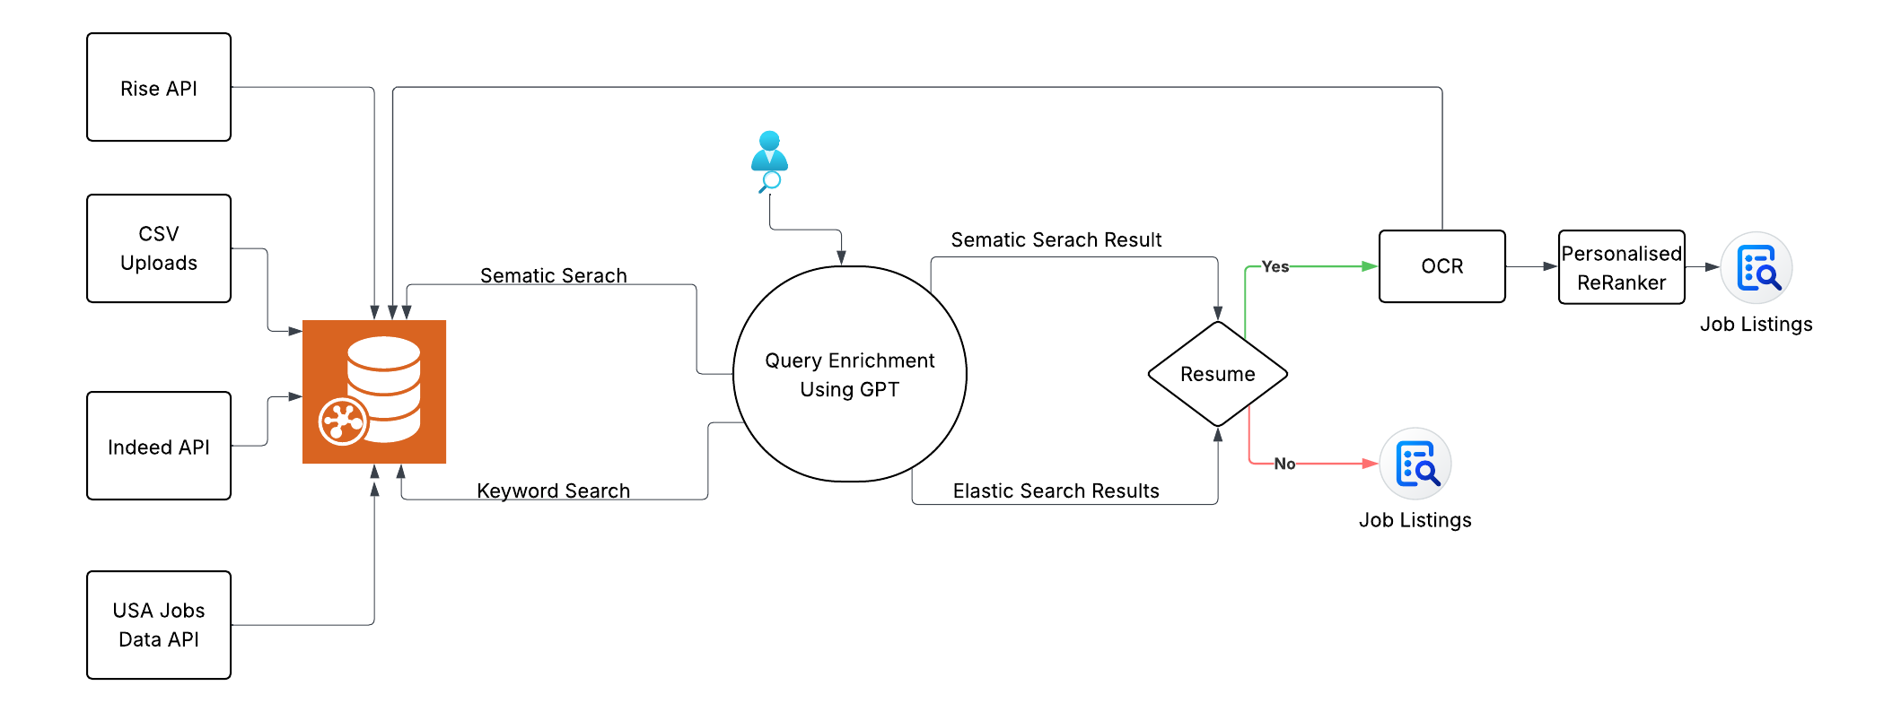
Search Paradigm

Slide 11
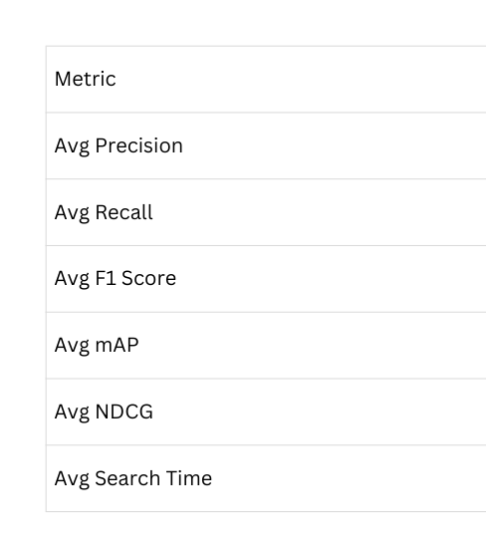
Results On Search (In Research)
Generic Search (Baselines)
Core of Job-Hunt AI
➡️ Strong precision but weak recall → system retrieves accurate but limited results
➡️ High NDCG indicates good ranking quality.

Slide 12
Thank You !!
We're here to help you with your job search journey and answer any questions.
Phone
+1 602-517-1664
Email
vyasmayank963@gmail.com
Website
https://mayankvyas-git-main-mayank-glitch-cpus-projects.vercel.app/

